Slide 1
Leave Tracker App (Capstone Project)
Presented by: SHASHANK GUPTA
Roll no: 0206CS221179

Slide 2
Problem Statement
Managing employee leave manually creates several challenges:
Errors in tracking leave balance – spreadsheets or manual records often lead to mistakes in calculating remaining leaves.
No visibility for managers – managers cannot easily track who is on leave, leading to scheduling conflicts.
Difficulty in approvals and reporting – approvals take time and lack transparency, while generating reports is slow and inaccurate.
Lack of centralized data – leave records are scattered across emails, paper forms, or files, making it hard to access historical data.
No real-time updates – employees and managers don’t get instant notifications on leave status.
Compliance issues – without proper rules, employees may apply for leaves beyond policy limits.

Slide 3
Objectives
Centralized Leave System – Employees can apply for leave online, managers approve, and balances update automatically.
Real-Time Visibility – Reports & Dashboards show leave status (Submitted, Approved, Rejected) for better planning.
Enforce Rules – Validation rules ensure no past dates, limit leave days, and require reasons for long leave.
User-Friendly UI (LWC) – Interactive interface for applying, tracking, and viewing leaves with integrated reports.

Slide 4
Technology Used
Salesforce CRM – Core platform to build, customize, and deploy the Leave Tracker app without external tools.
Lightning Web Components (LWC) – Created a modern, responsive interface for employees and managers.
Reports & Dashboards – Enabled real-time insights into leave trends, approvals, and pending requests.
Validation Rules – Enforced business policies (e.g., no past dates, max leave days, mandatory reasons).
App Builder – Used to configure pages, place components, and design a user-friendly interface.

Slide 5
System Design
Custom Object: Leave Application – Core record to store all employee leave requests.
Key Fields: Employee (User), Leave Type (Sick, Casual, Paid, Unpaid), Start Date, End Date, Reason, Status.
Approval Process: Automated workflow for Manager approval, updates status to Approved or Rejected.
Validation Rules: Ensures data accuracy → No past start dates, leave cannot exceed 30 days, reason required for long leaves.
User Interface: Built with App Builder and LWC for a simple and interactive experience.

Slide 6
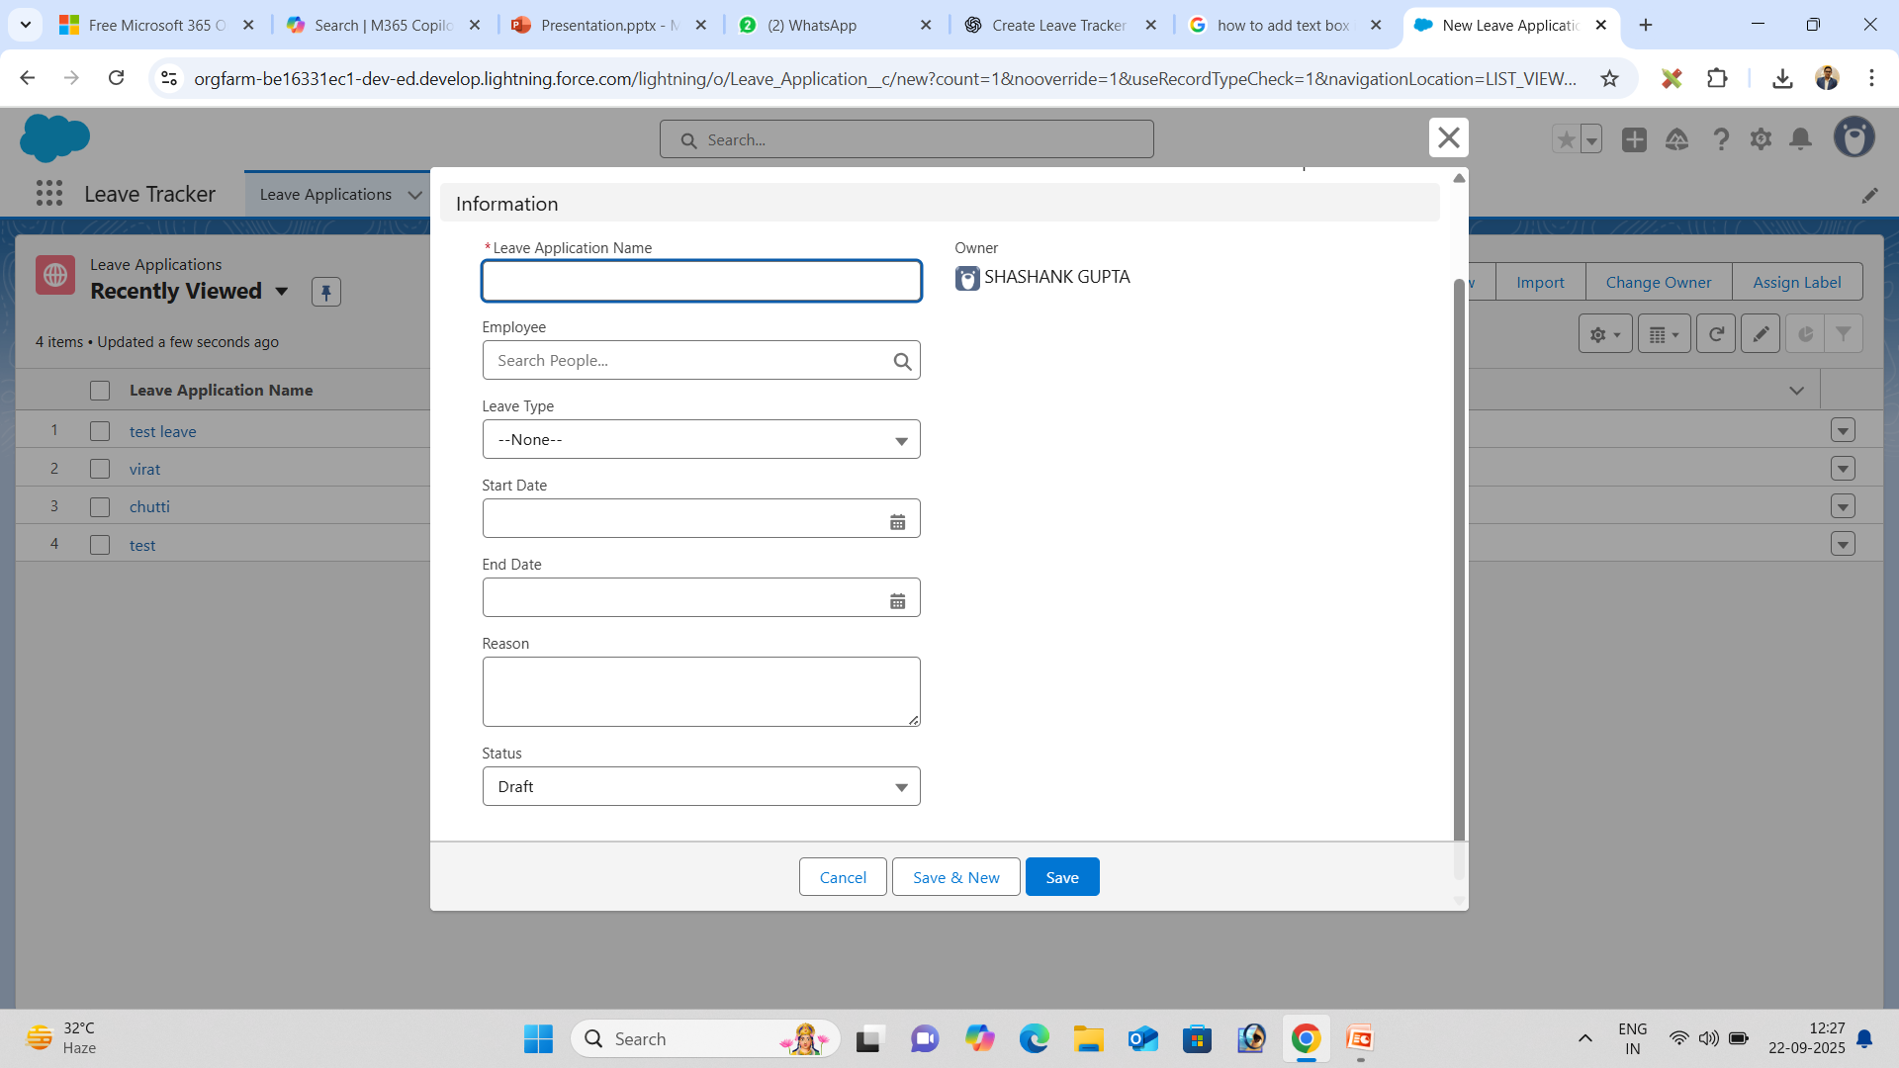
Screenshots

Slide 7
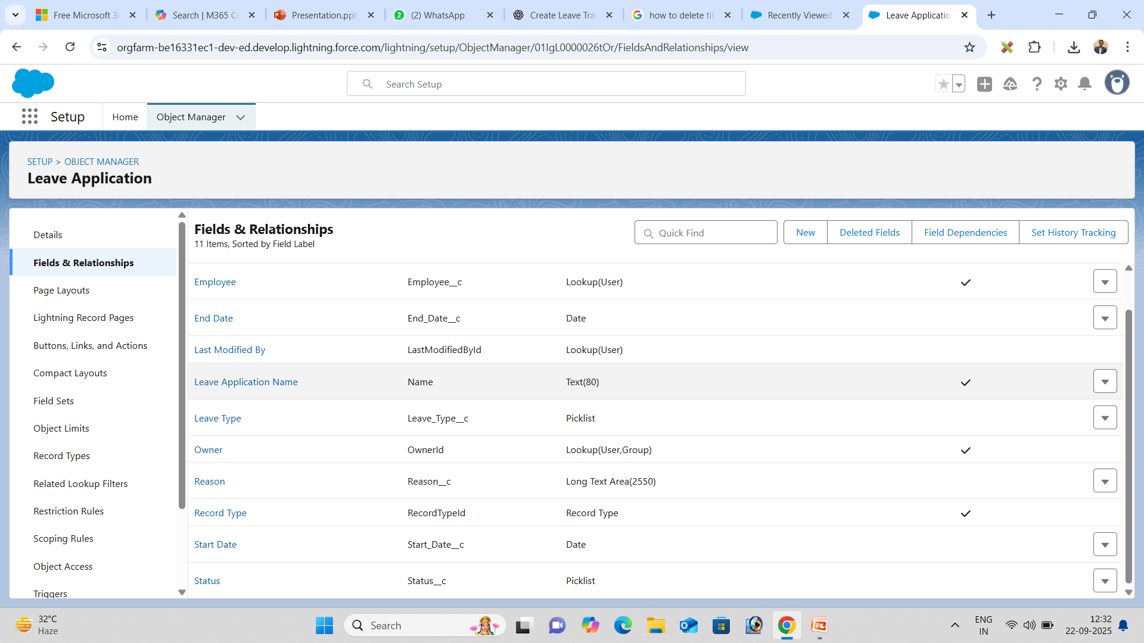

Slide 8
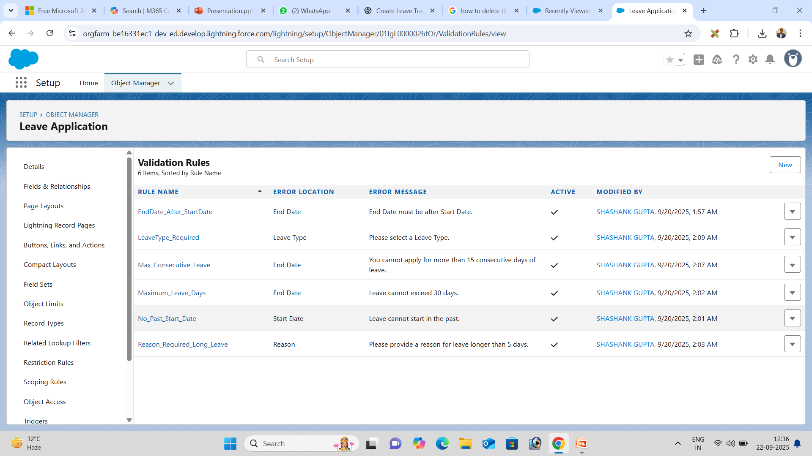

Slide 9
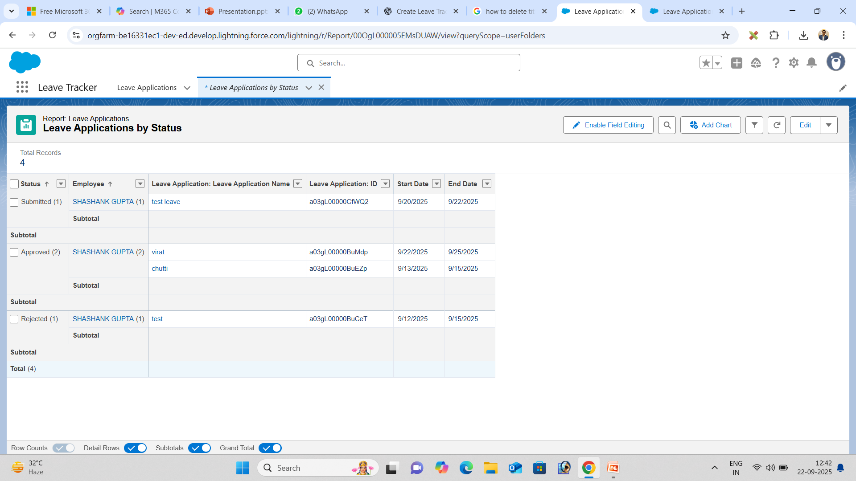

Slide 10
Benefits
Transparency in leave management – Employees and managers can see leave requests, status, and history at a glance.
Saves time for HR and employees – Automated approvals and notifications reduce manual effort and follow-ups.
Easy tracking of leave history – All leave records are stored in one central system, making it simple to review past leaves.
Insightful dashboards for decision making – Visual charts and reports help managers plan resources and monitor leave trends effectively.

Slide 11
Conclusion
Automated leave management with Salesforce – Employees can apply for leave, and the system handles approvals automatically.
Improved accuracy and transparency – Validation rules and automated workflows ensure correct leave records and visible status updates.
Easy monitoring through Reports & Dashboards – Managers can track pending, approved, and rejected leaves in real time with visual charts.
Scalable for future enhancements – The system can be extended to include features like PDF/Excel export, advanced validation rules, and HR analytics for better decision-making.

Slide 12
Thank You...

